Slide 1
Secrets to Building Lifetime Loyalty

Slide 2



Moderator
Craig Ricks » Paciolan
Presenters
Jason Cole » FanMaker
Milton Overton » University of Alabama
Perry Teague » NCR Corporation

Slide 3

Milton Overton
University of Alabama

Slide 4
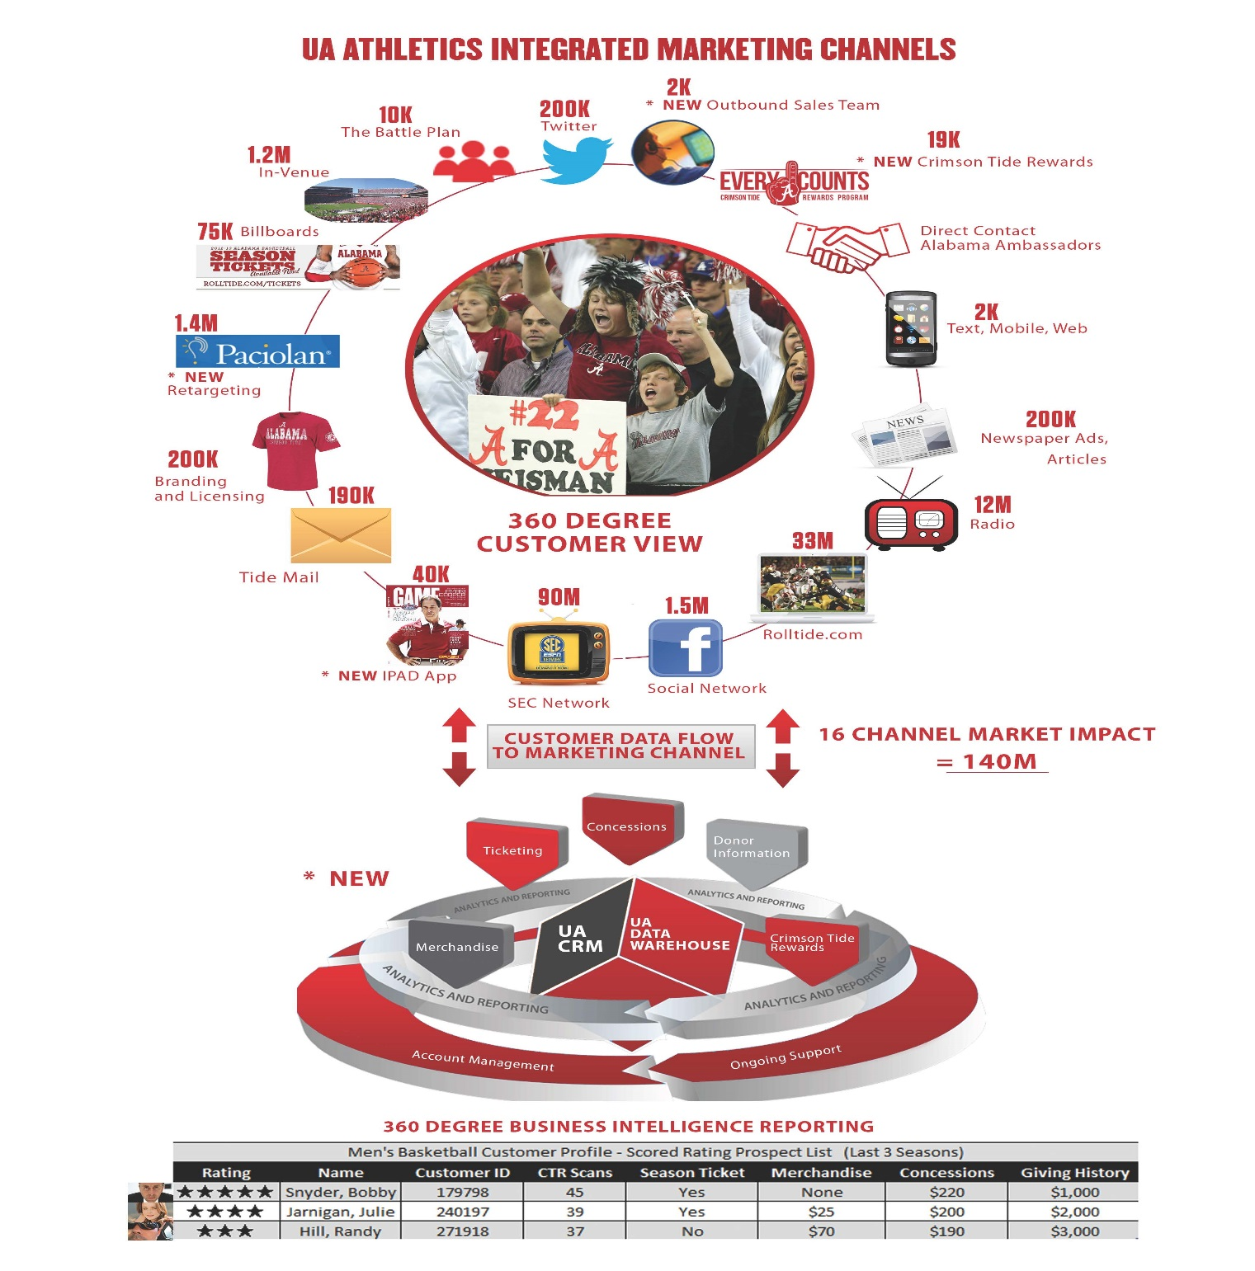

Slide 5
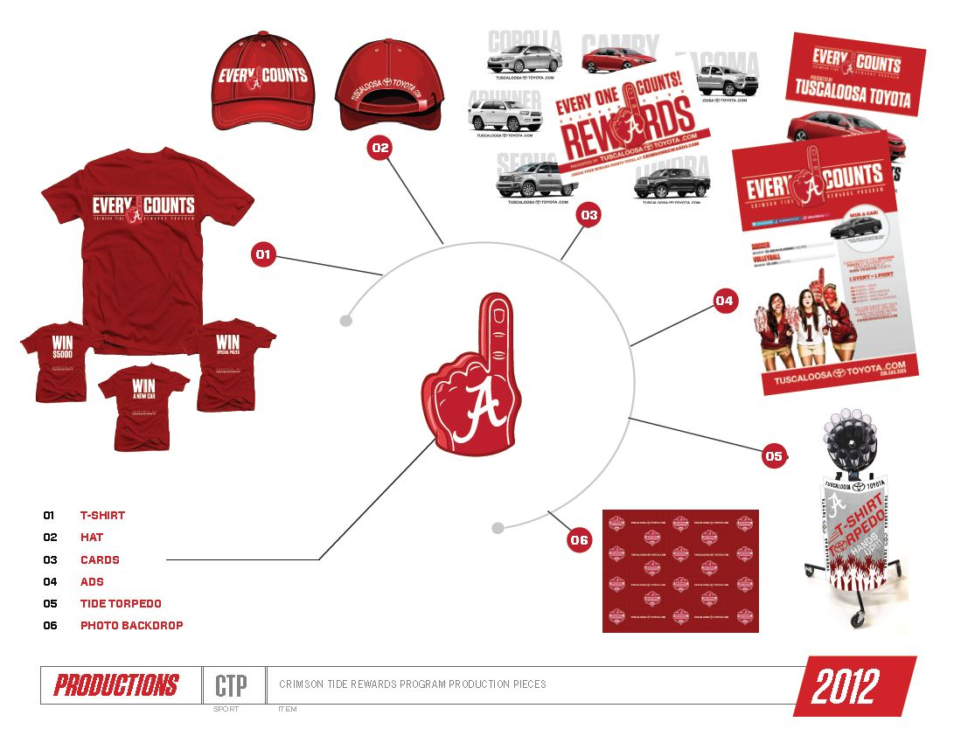

Slide 6
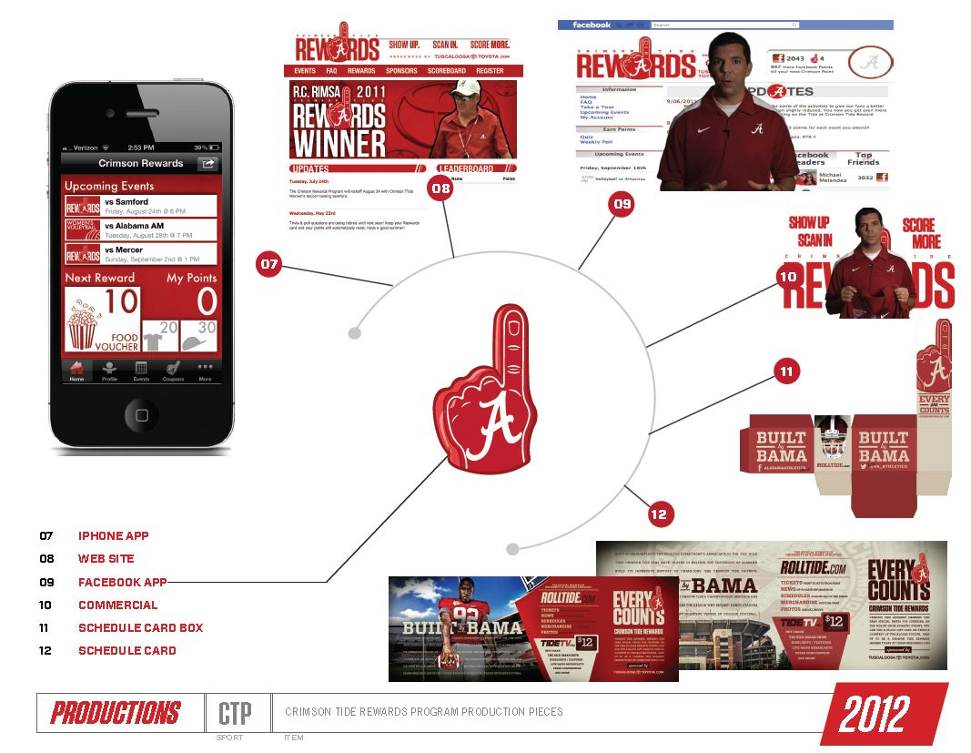

Slide 7
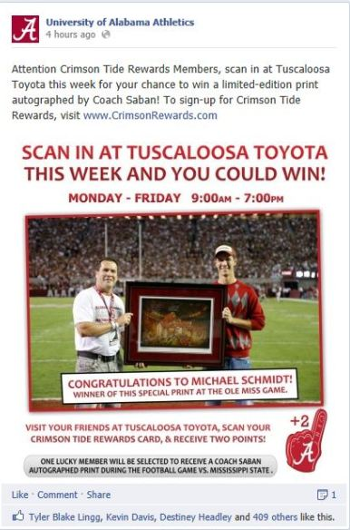
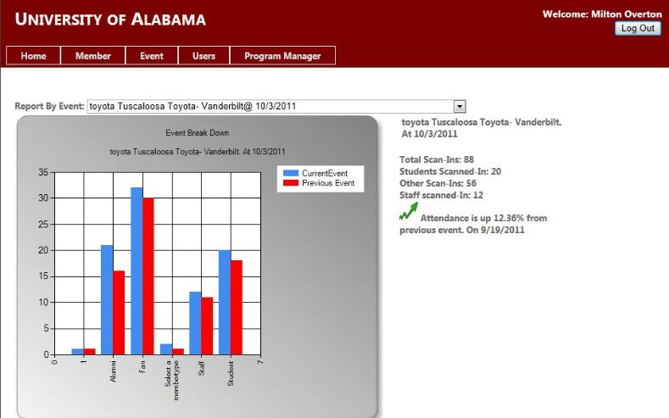
Sponsor Activation

Slide 8
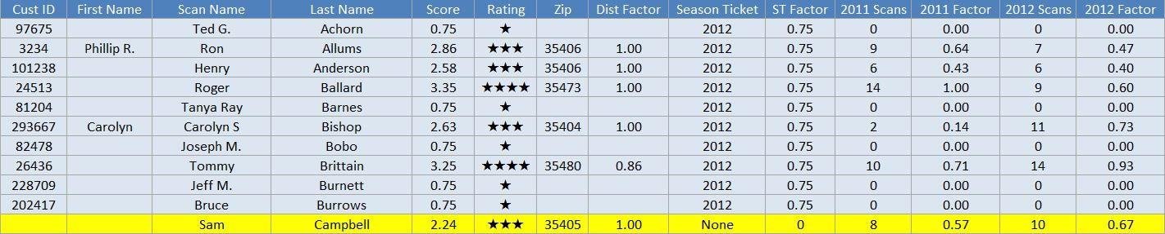
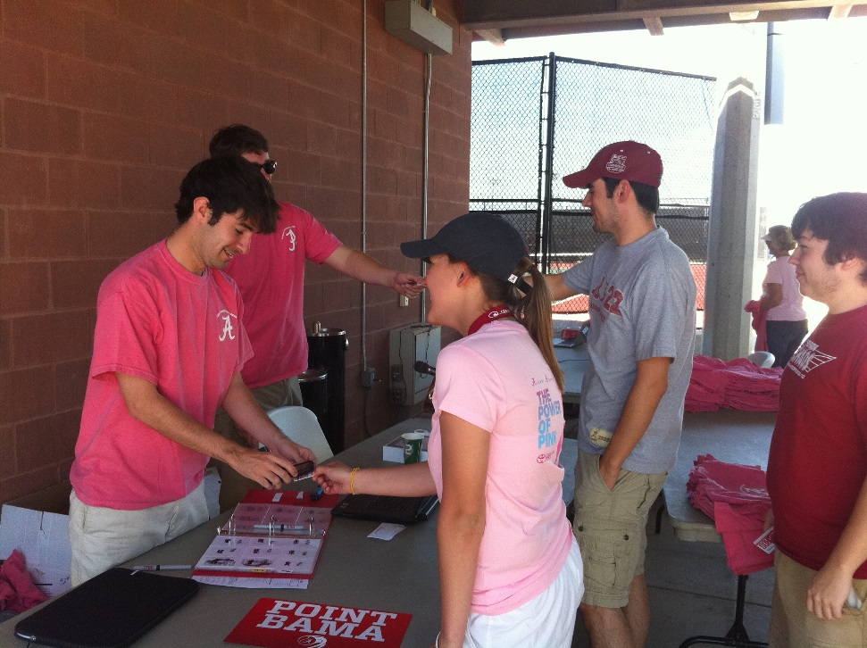
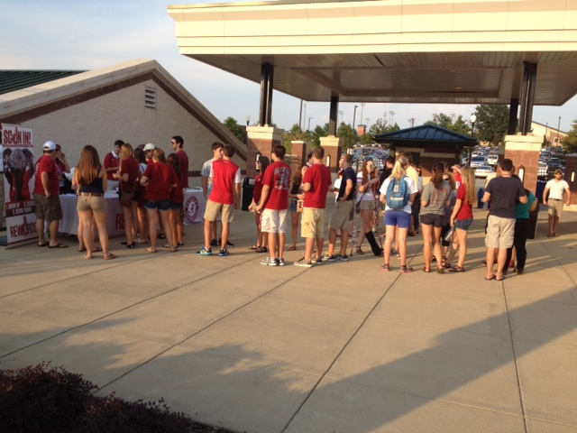
Data Purpose / Scored Prospect List

Slide 9
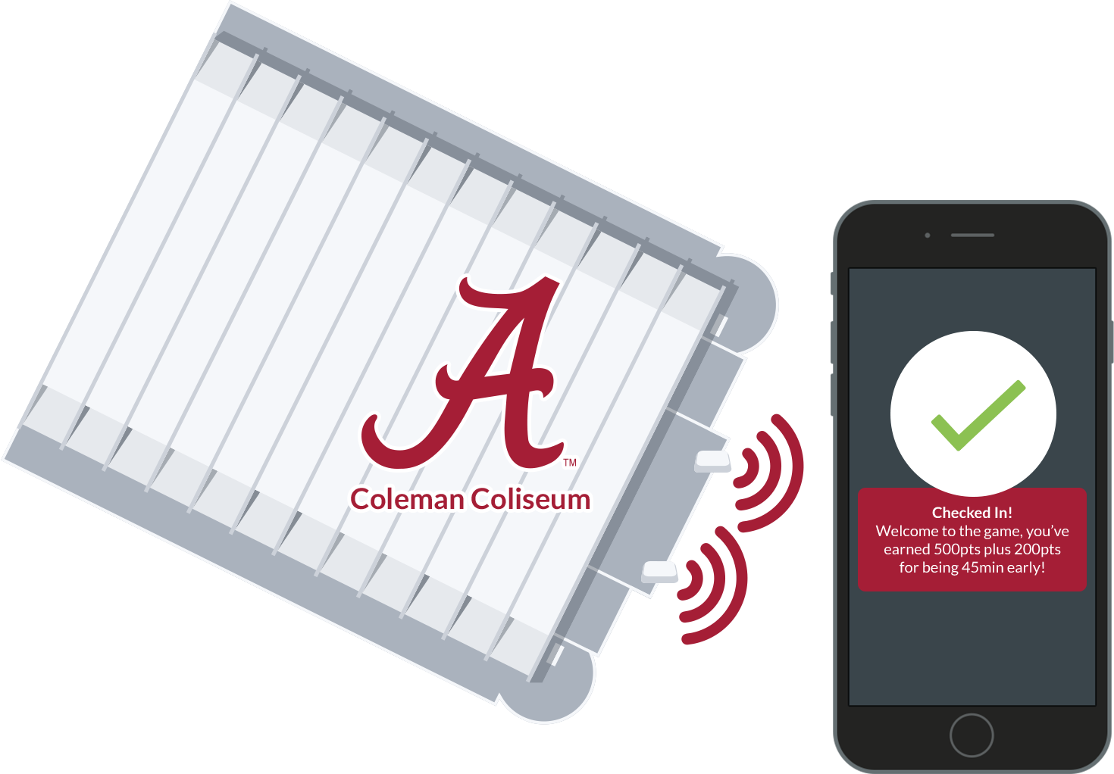
iBeacons

Slide 10
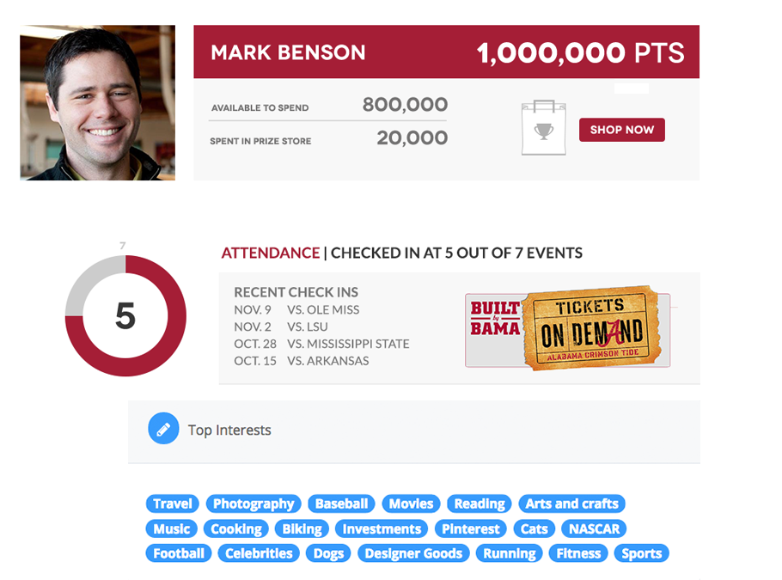
Fan Profile

Slide 11
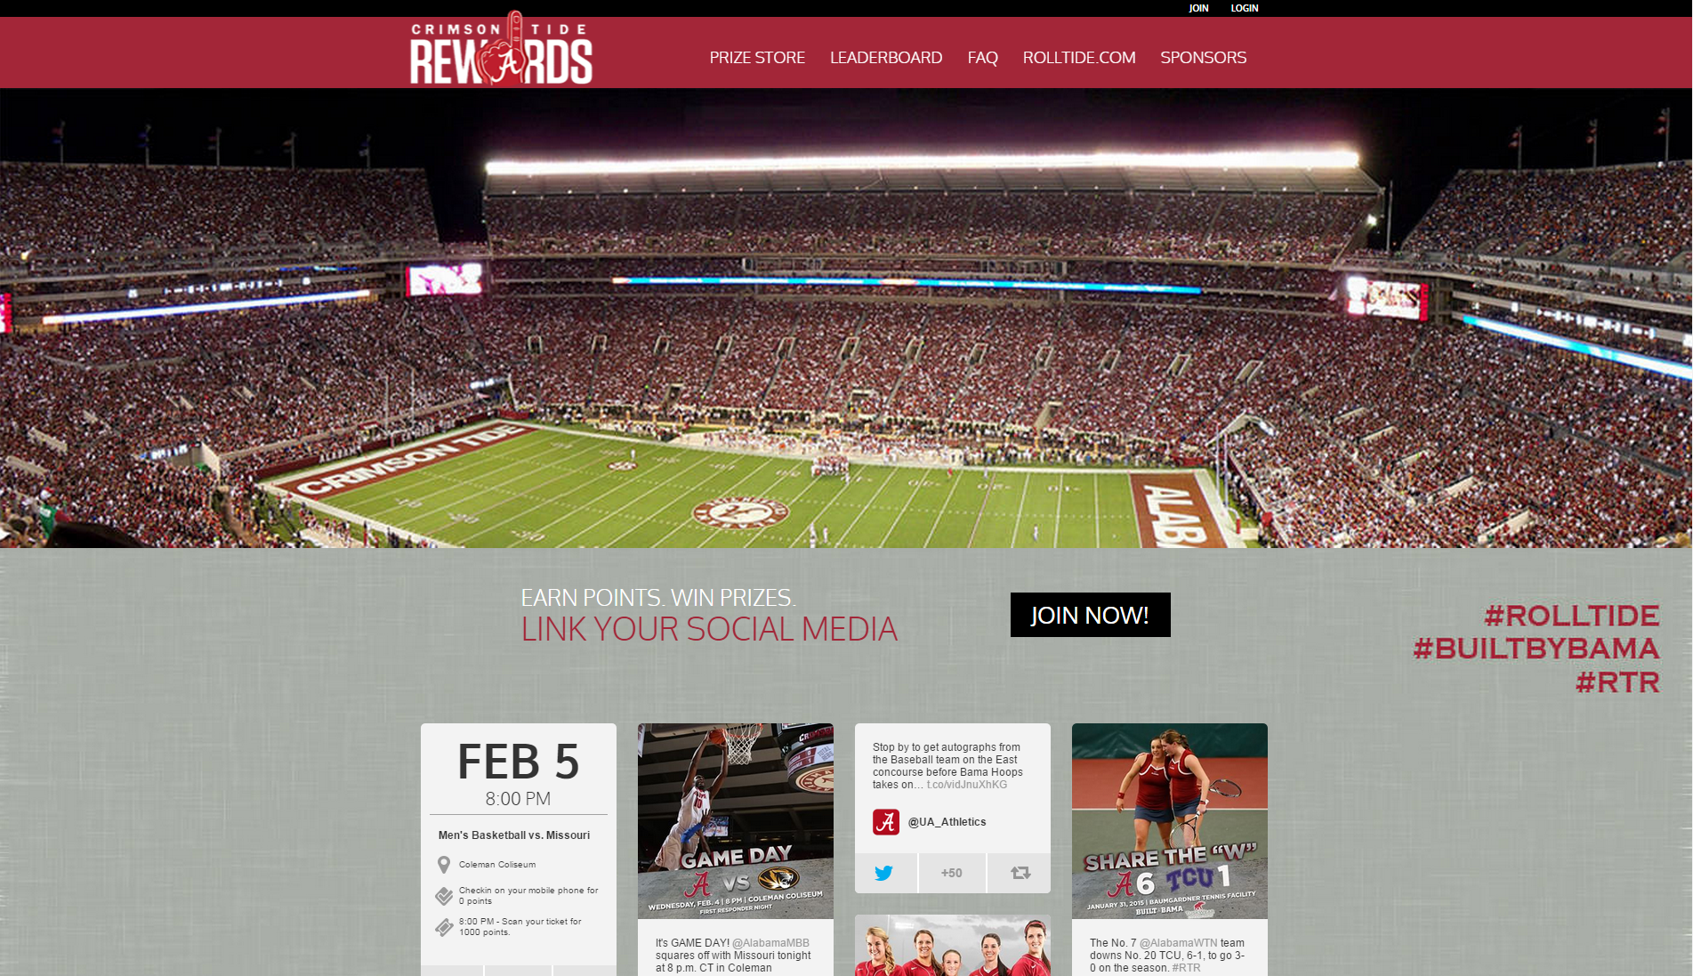
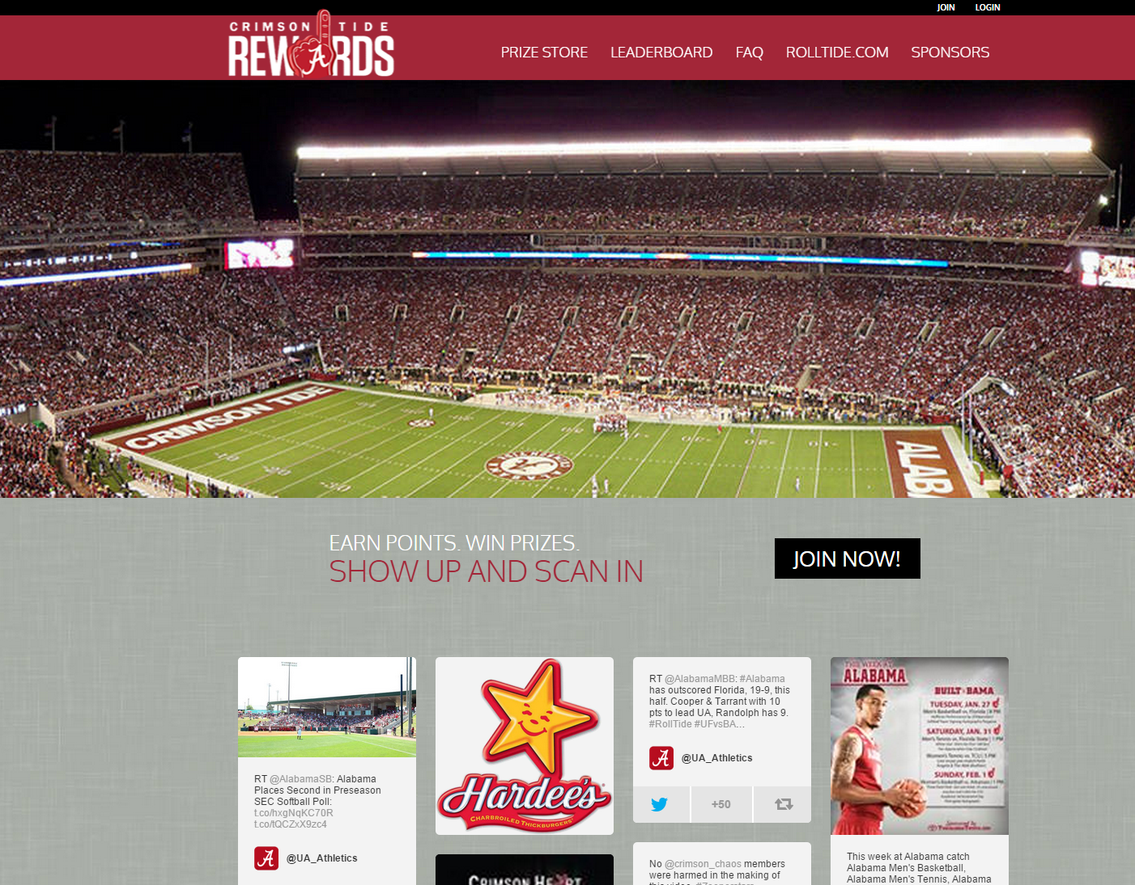
Sponsor Activation

Slide 12
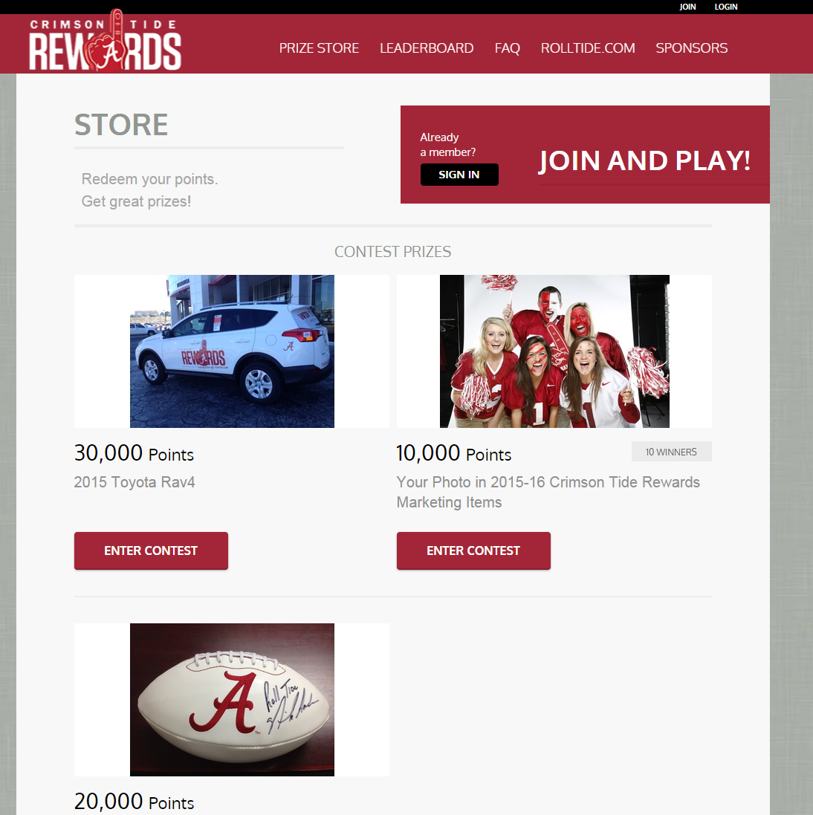
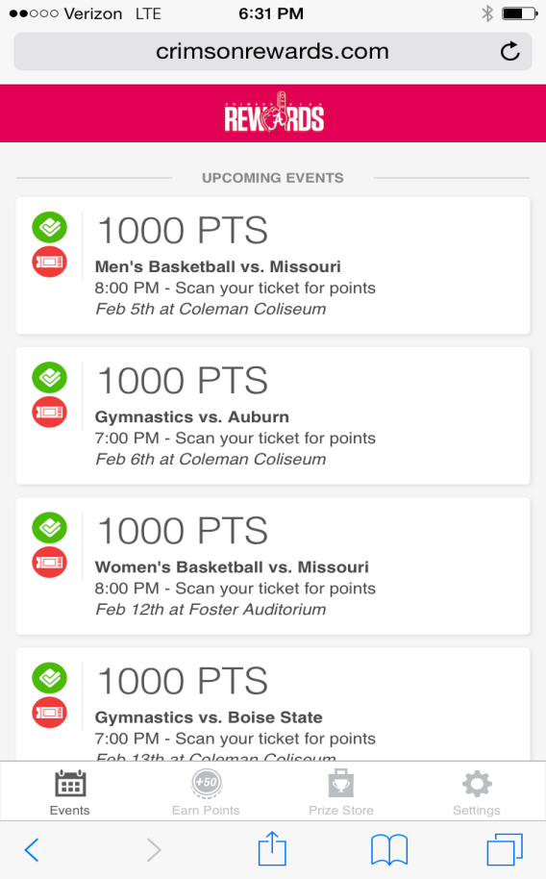
Rich Rewards

Slide 13
Thank you!
Questions

